Slide 1
8D Report for BFX-AT100 TV Screen shake
Prepared By: PQE/Rachel
Reviewed By: QA/Toney
Ben Trinh
Date: 2023-Dec-22

Slide 2
D1
Establish the Team
Team Leader
Team Member
PM: An Tran
PQE: Toney Tu, Rachel
TE: Mark Wu
PE : Jack Han/Micheal
RD: Tom / Cooper
  Operation leader: David Yin
  QA leader: CB Lin
Notes:
MA5800-X7#display cable modem <MAC> detail

Slide 3
D2
Description the Problem
Issue Description ( 5W2H)
When | 2023/05/27
Who | ALT customer
Where | SK networks warehouse, Anseong, Korea.
What | ALT customer feedback that they found out 1/1000pcs has TV screen shake. Defect rate: 1/1000 = 1000 DPPM
Why | Follow SoC (P/N: 002.02753.005. DC: 2223, LC: D20220605, Vendor: AMLOGIC)
How | TV screen shake
How many | Total 1pcs (Defect rate: 1/1000 = 1000 DPPM) as below table.
No | Description Issue | S/N | MAC | Fail rate
1 | TV screen shake | 2149688001202301080266 | BCF4D4F82447 | 1000 DPPM

Slide 4
D3
Containment Action
1. BFX-AT100 the TV screen shake this issue can not cover by test program on FATP.
2. From 14/June/2023 to now. Fii applies new test program into production to cover this issue. (Owner: TE Jones ,status: Done 06/14).
Notes:
5.26891E-07 4.96855E-07

Slide 5


D4
Root Cause Analysis
1. Background Information
On 27/May/2023, ALT customer feedback that they found out 1/1000pcs has TV screen shake.
Defect rate: 1/1000 = 1000 DPPM
Fail symptom: TV screen shake issue
TV screen shake
TV screen OK
Note: Please view video sample.
Notes:
MA5800-X7#display cable modem <MAC> detail

Slide 6


D4
Root Cause Analysis
2. Re-Test OBA + FATP Verify Result
1. Retest NG sample at OBA station.
TV screen shake
2. Upgrade again factory FW and test NG sample at FT, FT1 station, the result as below:
No. | Station | Result
1 | FT | Pass
2 | FT1 | Pass
Screen shake
Summary: The fail symptom same as customer feedback.
- Retest NG sample at FT, FT1 station ➔ Pass normally.
➔ FATP station can’t cover this issue
Notes:
MA5800-X7#display cable modem <MAC> detail

Slide 7
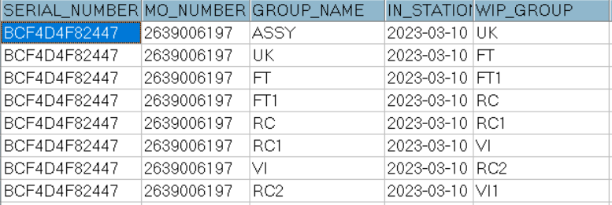
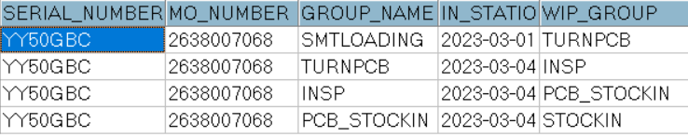
D4
Root Cause Analysis
3. System level
1. Recheck production data record.
2. Recheck test log
Dot level
T level
No# | Station | Status
1 | UK | Pass
2 | FT (test HDMI video noise) | Pass
3 | FT1(test HDMI ) | Pass
4 | RC | Pass
5 | RC1 | Pass
6 | RC2 | Pass
Summary:
- Recheck production data record and test log ➔ Did not find out any abnormal.
Notes:
MA5800-X7#display cable modem <MAC> detail

Slide 8
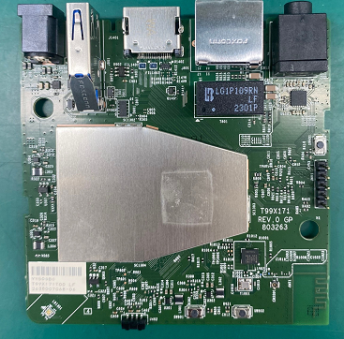
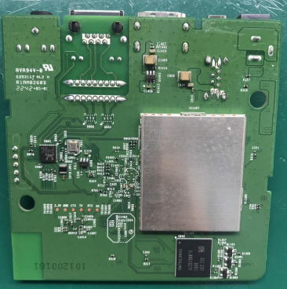
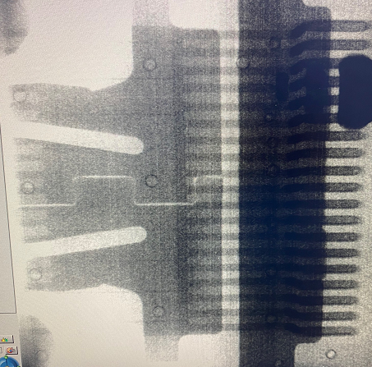

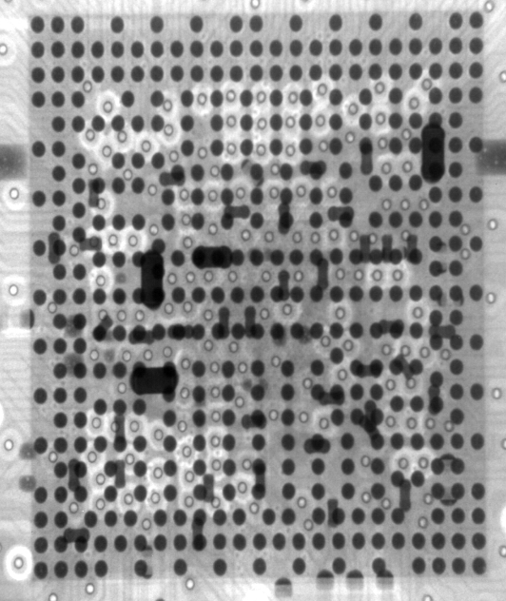
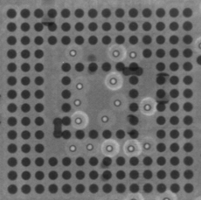
D4
Root Cause Analysis
4. Board level - 1
1. Check Visual inspection and take X-ray NG sample, result as below:
Item | Top side | Bottom side | Result
Visual inspection |  |  | No abnormality
Item | SoC | eMMC | HDMI Connector | Filter | Result
X-ray |  |  |  |  | No abnormality
Summary:
- Check visual inspection and take X-ray➔ Result: No abnormality
Notes:
MA5800-X7#display cable modem <MAC> detail

Slide 9
D4
Root Cause Analysis
5. Board level - 2
2. Measure impedance /VF on board HDMI connector of NG sample and compare with OK sample, result as table below:
Impedance/VF measurement on board HDMI Connector
Pin No | Pin Name | Description | NG sample |  | OK sample
 |  |  | Impedance (Ω) | VF | Impedance (Ω) | VF
1 | TX2+ | HDMI TMDS data2 negative output | 3.15M | 0.68 | 3.2M | 0.68
2 | TX2_shield | System Ground | 0 | 0 | 0 | 0
3 | TX2- | HDMI TMDS data2 positive output | 3.15M | 0.67 | 3.2M | 0.68
4 | TX1+ | HDMI TMDS data1 positive output | 3.15M | 0.67 | 3.2M | 0.68
5 | TX1_shield | System Ground | 0 | 0 | 0 | 0
6 | TX1- | HDMI TMDS data1 negative output | 3.15M | 0.64 | 3.2M | 0.68
7 | TX0+ | HDMI TMDS data0 positive output | 3.15M | 0.68 | 3.2M | 0.68
8 | TX0_shield | System Ground | 0 | 0 | 0 | 0
9 | TX0- | HDMI TMDS data0 negative output | 3.15M | 0.67 | 3.2M | 0.68
10 | TXC+ | HDMI TMDS clock positive output | 3.15M | 0.67 | 3.2M | 0.68
11 | TXC_shield | System Ground | 0 | 0 | 0 | 0
12 | TXC- | HDMI TMDS clock negative output | 3.1M | 0.68 | 3.2M | 0.68
13 | CEC | General purpose input/output bank H signal 3 | 2.0M | 0.69 | 2.2M | 0.69
14 | NC | Not Connect | NA | NA | NA | NA
15 | SCL | General purpose input/output bank H signal 1 | 1.03M | 0.6 | 1.2M | 0.62
16 | SDA | General purpose input/output bank H signal 0 | 1M | 0.6 | 1.01M | 0.61
17 | GND | System Ground | 0 | 0 | 0 | 0
18 | 5V | HDMI_PW | 1.0M | 0.49 | 1.2M | 0.55
19 | HPD | General purpose input/output bank H signal 2 | 109.6K | 0.69 | 110K | 0.69
Summary: Did not find out abnormal with impedance of NG sample
Notes:
MA5800-X7#display cable modem <MAC> detail

Slide 10
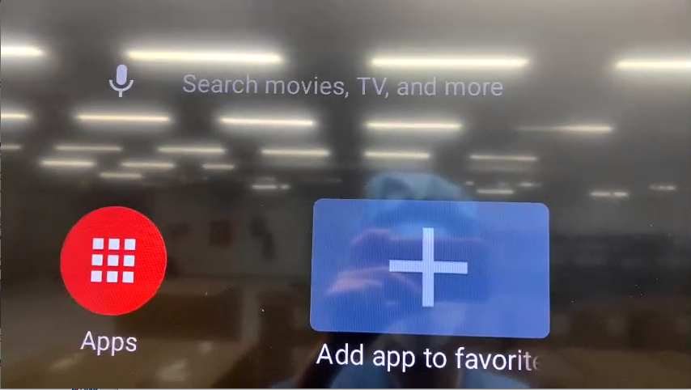
D4
Root Cause Analysis
6. Board level - 3
3. Change component of HDMI block and retest screen TV. :
- Change new FIL1401, FIL1402, J1401.
Result: Fail. This issue not follow FIL1401, FIL1402, J1401 component.
- Change new SoC
➔ Result: Pass. This issue follow SoC component.
TV screen OK
Summary:
- This issue follow SoC (P/N: 002.02753.005, DC: 2223, LC: D20220605, Vendor: AMLOGIC) material have issue.
Notes:
MA5800-X7#display cable modem <MAC> detail

Slide 11
D4
Root Cause Analysis
7. Component level - 1
1. Removed SoC and measure HDMI block pin, result as table below:
SoC-U1 HDMI pin impedance measurement
SoC_PIN NAME | Description | OK SoC Sample |  | NG SoC sample
 |  | Impedance | VF | Impedance | VF
C43 | HDMI TMDS data2 negative output | 7.4MΩ | 0.76 | 7.32MΩ | 0.765
C45 | HDMI TMDS data2 positive output | 7.42MΩ | 0.76 | 7.32MΩ | 0.765
E45 | HDMI TMDS data1 positive output | 7.41MΩ | 0.76 | 7.35MΩ | 0.765
G43 | HDMI TMDS data1 negative output | 7.42MΩ | 0.76 | 7.34MΩ | 0.764
J41 | HDMI TMDS data0 positive output | 7.42MΩ | 0.76 | 7.23MΩ | 0.764
J43 | HDMI TMDS data0 negative output | 7.41MΩ | 0.76 | 7.32MΩ | 0.764
L43 | HDMI TMDS clock positive output | 7.42MΩ | 0.76 | 7.32MΩ | 0.763
L45 | HDMI TMDS clock negative output | 7.45MΩ | 0.76 | 7.38MΩ | 0.763
N41 | General purpose input/output bank H signal 1 | 2.52MΩ | 0.71 | 2.756MΩ | 0.721
N43 | General purpose input/output bank H signal 3 | 2.64MΩ | 0.75 | 2.791MΩ | 0.744
R43 | General purpose input/output bank H signal 0 | 2.49MΩ | 0.71 | 2.760MΩ | 0.721
R45 | General purpose input/output bank H signal 2 | 2.61MΩ | 0.74 | 2.763MΩ | 0.729
AG45 | General purpose input/output bank H signal 4 | 2.91MΩ | 0.78 | 3.256MΩ | 0.788
Summary: Measure impedance/VF HDMI pins of NG SoC ➔ Did not find out any abnormality
Notes:
MA5800-X7#display cable modem <MAC> detail

Slide 12
D4
Root Cause Analysis
8. Component level - 2
2. Reball and do a swap verification SoC
Check Screen HDMI | 1 | 2 | 3
OK board + OK SoC | OK | OK | OK
NG board + NG SoC | NG | NG | NG
OK board + NG SoC | NG | NG | NG
NG broad + OK SoC | OK | OK | OK
Summary:
- As analyzed above this issue follow U1-SoC( P/N: 002.2753.005, DC: 2223, LC: D20220605, Vendor: AMLOGIC ) component.
Notes:
MA5800-X7#display cable modem <MAC> detail

Slide 13
D4
Conclusion Root Cause
As base analysis:
Occur cause: Follow SoC (P/N: 002.02753.005, DC: 2223, LC: D20220605, Vendor: AMLOGIC)
have material issue.
Escape cause: FATP can’t cover TV screen shake issue.
Notes:
MA5800-X7#display cable modem <MAC> detail

Slide 14
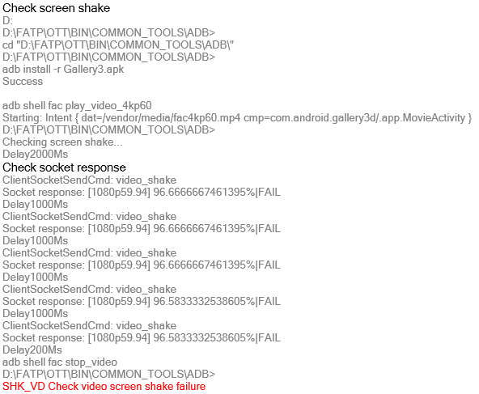
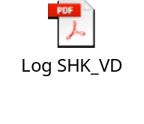
D5
Corrective Action (Short term)
1. Update new test program
- RD improves the test program at FT1 station to cover screen shake issue.
(Done, RD Jerry improved test program and sent to factory for verification)
- TE Jones used NG unit which detected by customer to verify new test program 5times, result as table below:
Test times | Result
1 | Fail
2 | Fail
3 | Fail
4 | Fail
5 | Fail
Verification result
SHK_VD Check video screen shake failure at FT1 station
Summary: As the verification result, new test program can cover screen shake issue. Therefore, Fii applies new test program into production to cover this issue. (Owner: TE Jones ,status: Done 06/14).
Notes:
MA5800-X7#display cable modem <MAC> detail

Slide 15
D5
Corrective Action (Fii Action)
Fii Action:
Short term:
Verify new test program by NG sample which can cover this issue on FATP and from 14/Jun/2023 to now. Apply new test program have check shake item. 14/Jun/2023 Closed
Long term:
- Send the NG SoC material to AMLOGIC vendor futher analyze. Owner: SQE Naomi .Status: Closed
- Fii will keeping monitor for this issue on FATP. Status: On-going
Notes:
MA5800-X7#display cable modem <MAC> detail

Slide 16
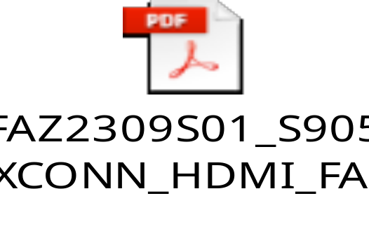
D5
Corrective Action (Amlogic Action)
Amlogic vendor action:
1. The chip passed visual inspection and SAT.
2. The chip could bootup normally and duplicated dynamic image shake when VDDEE voltage was between 0.815V to 0.84V in Socket board.
3. The chip failed FT with function failure caused by chip encryption. The chip was not observed Pin Open/Short.
4. Through the RD analysis, the shake phenomenon was caused by VPU module abnormal
Conclusion:
- Based on FA result, the shake screen caused by VPU error is the only one case based on the Amlogic's RMA history records.
Amlogic recommends keeping monitor due to the low DPPM(<50dppm).
- Amlogic vendor hope that ALT customer will support decryption the SoC for amlogic vendor to further analysis.
- Request Amlogic vendor update new test plan to cover issue.
Notes:
5.26891E-07 4.96855E-07

